Slide 1
Collections in Java: ArrayList
Building Java Programs
Chapter 10
Data structure and algorithms
Chapter 6

Slide 2
Collections
collection: an object that stores data; a.k.a. "data structure"
  the objects stored are called elements
  some collections maintain an ordering; some allow duplicates
  typical operations: add, remove, clear, contains (search), size
  examples found in the Java class libraries:
    ArrayList, LinkedList, HashMap, TreeSet, PriorityQueue
  all collections are in the java.util package
    import java.util.*;

Slide 3
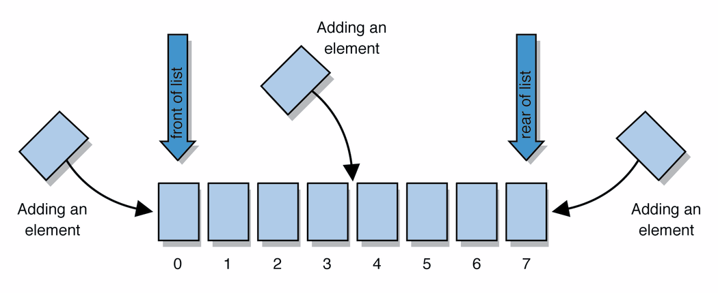
Lists
list: a collection storing an ordered sequence of elements
  each element is accessible by a 0-based index
  a list has a size (number of elements that have been added)
  elements can be added to the front, back, or elsewhere
  in Java, a list can be represented as an ArrayList object

Slide 4
Idea of ArrayList<>
ArrayList<E> where E indicates the type of items that will be included in the ArrayList, is a class that lets you collect objects just like an array does; but it has two significant conveniences:
  ArrayList can grow and shrink as needed (it is initially an empty list).
  ArrayList class supplies methods for many common tasks, such as inserting and removing elements
    The default behavior is to add to the end of the list.
ArrayList keeps track of the element values that have been added to it, their order, indexes, and its total size.
  Think of an "array list" as an automatically resizing array object.
  Internally, the list is implemented using an array and a size field.

Slide 5
Type Parameters (Generics)
ArrayList<Type> name = new ArrayList<Type>();
When constructing an ArrayList, you must specify the
type of elements it will contain between < and >.
  This is called a type parameter or a generic class.
Example
  ArrayList<String> names = new ArrayList<String>();
  names.add("Marty Stepp");
  names.add("Stuart Reges");
When you construct an array list, it has a size 0
  The size increases every time an element is added to the array list
  The size method yields number of elements

Slide 6
ArrayList methods (10.1)
add(value) | appends value at end of list
add(index, value) | inserts given value just before the given index, shifting subsequent values to the right
clear() | removes all elements of the list
indexOf(value) | returns first index where given value is found in list (-1 if not found)
get(index) | returns the value at given index
remove(index) | removes/returns value at given index, shifting subsequent values to the left
set(index, value) | replaces value at given index with given value
size() | returns the number of elements in list
toString() | returns a string representation of the list such as "[3, 42, -7, 15]"
contains(value) | returns true if given value is found somewhere in this list
lastIndexOf(value) | returns last index value is found in list (-1 if not found)

Slide 7
add and set methods
ArrayList<String> names = new ArrayList<String>();
System.out.println("Names = " + names);
names.add("Marty Stepp");
System.out.println(“Names = " + names);
names.add("Stuart Reges");
System.out.println("Names = " + names);
names.add(0, "Hello");
System.out.println("Names = " + names);
names.add(2, "and");
System.out.println("Names = " + names);
names.set(2, "or");
System.out.println("Names = " + names);
Output
      Names = []
      Names = [Marty Stepp]
      Names = [Marty Stepp, Stuart Reges]
      Names = [Hello, Marty Stepp, Stuart Reges]
      Names = [Hello, Marty Stepp, and, Stuart Reges]
      Names = [Hello, Marty Stepp, or, Stuart Reges]

Slide 8
get and remove methods
Removing moves all elements after the removed element down by one position, and reduces the size of the array list by 1
  ArrayList<String> names = new ArrayList<String>();
  names.add("Marty Stepp");
  names.add("Stuart Reges");
  names.add(0, “Hello");
  names.add(2, “and");
  names.set(2, “or");
  System.out.println(“Names = ” + names);
  System.out.println(names.get(2));
  names.remove(2);
  System.out.println(names.get(2));
  System.out.println(“Names = ” + names);
      Output
      Names = [Hello, Marty Stepp, or, Stuart Reges]
      Or
      Stuart Reges
      Names = [Hello, Marty Stepp, Stuart Reges]

Slide 9
ArrayList vs. array
construction
  String[] names = new String[5];
  ArrayList<String> list = new ArrayList<String>();
storing a value
  names[0] = "Jessica";
  list.add("Jessica");
retrieving a value
  String s = names[0];
  String s = list.get(0);
seeing whether the value "Benson" is found
  for (int i = 0; i < names.length; i++) {
  if (names[i].equals("Benson")) { ... }
  }
  if (list.contains("Benson")) { ... }

Slide 10
Searching Methods
Suppose that file of names which has some duplicates. You want to write a program that gets rid of the duplicates.
  Maria Derek Erica
  Livia Jack Anita
  Kendal Maria Livia Derek
  Jamie Jack
  Erica
  ArrayList<String> list = new ArrayList<String>();
  Scanner input = new Scanner(new File("words.txt"));
  while (input.hasNext()) {
  String name= input.next();
  if (!list.contains(name) {
  list.add(name);
  }
  }
    System.out.println("list = " + list);
  Output
  List = [Maria, Derek, Erica, Livia, Jack, Anita, Kendal, Jamie]

Slide 11
ArrayList as parameter
public static void name(ArrayList<Type> name) {
Example:
//search for a string target and replace it with replacement
public static void replace (ArrayList<String> list,
String target, String replacement){
int index = list.indexOf(target);
if (index>=0){
list.set(index, replacement)
}
}
You can also return a list:
public static ArrayList<Type> methodName(params)

Slide 12
ArrayList of primitives?
The type you specify when creating an ArrayList must be an object type; it cannot be a primitive type.
  You cannot insert primitive types directly into array lists
  // illegal -- int cannot be a type parameter
  ArrayList<int> list = new ArrayList<int>();
But we can still use ArrayList with primitive types by using special classes called wrapper classes in their place.
A wrapper is an object whose sole purpose is to hold a primitive value.
  // creates a list of ints
  ArrayList<Integer> list = new ArrayList<Integer>();

Slide 13
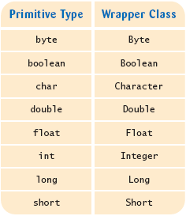
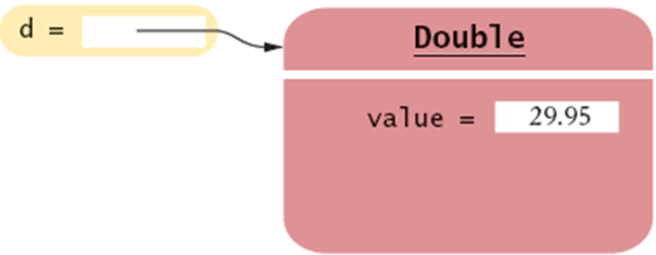
Wrappers
ArrayList<Double> data = new ArrayList<Double>();
data.add(29.95);
double x = data.get(0);
Double d = 29.95; // auto-boxing; same as Double d = new Double(29.95);
double x = d; // auto-unboxing; same as double x = d.doubleValue();

Slide 14
Wrapper classes and Generalized for
Traverses all elements of a collection:
ArrayList<Integer> list= new ArrayList<Integer>();
list.add(13);
list.add(47); //autoboxing
list.add(9);
int sum = 0;
for (int n : list) // You should read this loop as "for each n in list"
{
sum = sum + n; //unboxing
}
System.out.println(“list =“ + list);
System.out.println(“sum =“ + sum);
Another unboxing example
int product = list.get(0)*list.get(1) ;

Slide 15
Out-of-bounds
Legal indexes are between 0 and the list's size() - 1.
  Reading or writing any index outside this range will cause an IndexOutOfBoundsException.
  ArrayList<String> names = new ArrayList<String>();
  names.add("Marty"); names.add("Kevin");
  names.add("Vicki"); names.add("Larry");
  System.out.println(names.get(0)); // okay
  System.out.println(names.get(3)); // okay
  System.out.println(names.get(-1)); // exception
  names.add(9, "Aimee"); // exception
index | 0 | 1 | 2 | 3
value | Marty | Kevin | Vicki | Larry

Slide 16
Complete Example for you to read and execute
// Each BankAccount object represents account information for a bank customer.
// We use private fields and public methods to make sure that the user
// cannot ever have a negative account balance.
import java.util.*; // for ArrayList
public class BankAccount {
// An object can have an array list, or other collection as a field.
private int id;
private double balance;
private ArrayList<String> transactions;
// Constructs a new account with the given ID and a balance of $0.00.
public BankAccount(int accountID) {
id = accountID;
balance = 0.0;
transactions = new ArrayList<String>();
}

Slide 17
Complete Example
// Deposits the given amount of money into the user's account.
// If the deposit amount is too big (more than $500), or if it is
// negative, the method does nothing.
// Also records a log entry of the deposit to be printed later.
public void deposit(double money) {
if (0 <= money) {
balance = balance + money;
transactions.add("Deposit of $" + money);
}
}

Slide 18
Complete Example
// Withdraws the given amount of money from the user's account.
// If the user does not have enough money, or if the amount of money is negative, the
// method does nothing. Also records a log entry of the withdrawal to be printed later.
public void withdraw(double money) {
if (0 <= money && money <= balance) {
balance = balance - money;
transactions.add("Withdrawal of $" + money);
}
}
// Returns the account user's current balance.
public double getBalance() {
return balance;
}
// Returns the account user's ID number.
public double getID() {
return id;
}

Slide 19
Complete Example
// Prints a log of all transactions (deposits and withdrawals) that have
// been made on this account, one per line.
public void printLog() {
for (int i = 0; i < transactions.size(); i++) {
String element = transactions.get(i);
System.out.println(element);
}
}
}

Slide 20
Complete Example -Test Program
// This 'client' program uses a BankAccount object and calls
// the printLog method we wrote in class.
public class UseAccount {
public static void main(String[] args) {
BankAccount marty = new BankAccount(19);
marty.deposit(7.84);
marty.withdraw(2.53);
marty.deposit(6.19);
marty.deposit(2.58);
marty.withdraw(999.99); // should fail (no transaction log)
marty.printLog();
System.out.println();
marty.withdraw(4.18);
marty.deposit(-123.45); // should fail (no transaction log)
marty.printLog();
}
}

Slide 21
The Collections class
Method name | Description
binarySearch(list, value) | returns the index of the given value in a sorted list (< 0 if not found)
copy(listTo, listFrom) | copies listFrom's elements to listTo
emptyList(), emptyMap(), emptySet() | returns a read-only collection of the given type that has no elements
fill(list, value) | sets every element in the list to have the given value
max(collection), min(collection) | returns largest/smallest element
replaceAll(list, old, new) | replaces an element value with another
reverse(list) | reverses the order of a list's elements
shuffle(list) | arranges elements into a random order
sort(list) | arranges elements into ascending order
Syntax: Collections.methodName(parameters)

Slide 22
The compareTo method
Collections.sort() method can be used to sort an ArrayList.
  Part of java.util package.
import java.util.*;
public class SortExample {
public static void main(String[] args) {
ArrayList<String> words = new ArrayList<String>();
words.add("four");
words.add("score");
words.add("and");
words.add("seven");
words.add("years");
words.add("ago");
// show list before and after sorting
System.out.println("before sort, words = " + words);
Collections.sort(words);
System.out.println("after sort, words = " + words);
}
}

Slide 23
The compareTo method
Can we a write similar program to sort an ArrayList<Point>?
  The program will not compile
Why it is possible to sort an ArrayList<String> but not an ArrayList<Point>?
  String class implements Comparable interface while Point class does not.
  String class defines a comparison function for its objects by implementing a compareTo method.
    public int compareTo(String other)
  A call of A.compareTo(B) will return:
    a value < 0 if A comes "before" B in the ordering,
    a value > 0 if A comes "after" B in the ordering,
    or 0 if A and B are considered "equal" in the ordering.

Slide 24
Using compareTo
Also wrapper classes implement compareTo of the Comparable interface
compareTo can be used as a test in an if statement.
  String a = "alice";
  String b = "bob";
  if (a.compareTo(b) < 0) { // true
  ...
  }
Primitives | Objects (String, Integer, Double, etc.)
if (a < b) { ... | if (a.compareTo(b) < 0) { ...
if (a <= b) { ... | if (a.compareTo(b) <= 0) { ...
if (a == b) { ... | if (a.compareTo(b) == 0) { ...
if (a != b) { ... | if (a.compareTo(b) != 0) { ...
if (a >= b) { ... | if (a.compareTo(b) >= 0) { ...
if (a > b) { ... | if (a.compareTo(b) > 0) { ...

Slide 25
compareTo and collections
Classes that implement the Comparable interface can use some built-in methods for sorting lists and for speeding up searches.
You can use an array or list of strings with Java's included binary search method because it calls compareTo internally.
  String[] a = {"al", "bob", "cari", "dan", "mike"};
  int index = Arrays.binarySearch(a, "dan"); // 3

Slide 26
Ordering your own types
You can have your own classes implement the Comparable interface and define a natural ordering function for their objects
  Then you use Java built-in methods for sorting lists and speeding up searches.
Comparable Interface
    public interface Comparable<E> {
    public int compareTo(E other);
    }
A call to your compareTo method should return:
  a value < 0 if the other object comes "before" this one,
  a value > 0 if the other object comes "after" this one,
  or 0 if the other object is considered "equal" to this.

Slide 27
Comparable template
public class name implements Comparable<name> {
...
public int compareTo(name other) {
...
}
}

Slide 28
Comparable example
public class Point implements Comparable<Point> {
private int x;
private int y;
...
// sort by x and break ties by y
public int compareTo(Point other) {
if (x < other.x) {
return -1;
} else if (x > other.x) {
return 1;
} else if (y < other.y) {
return -1; // same x, smaller y
} else if (y > other.y) {
return 1; // same x, larger y
} else {
return 0; // same x and same y
}
}
}

Slide 29
compareTo tricks
subtraction trick - Subtracting related numeric values produces the right result for what you want compareTo to return:
  // sort by x and break ties by y
  public int compareTo(Point other) {
  if (x != other.x) {
  return x - other.x; // different x
  } else {
  return y - other.y; // same x; compare y
  }
  }
  The idea:
    if x > other.x, then x - other.x > 0
    if x < other.x, then x - other.x < 0
    if x == other.x, then x - other.x == 0

Slide 30
compareTo tricks 2
delegation trick - If your object's fields are comparable (such as strings), use their compareTo results to help you:
  // sort by employee name, e.g. "Jim" < "Susan"
  public int compareTo(Employee other) {
  return name.compareTo(other.getName());
  }
toString trick - If your object's toString representation is related to the ordering, use that to help you:
  // sort by date, e.g. "09/19" > "04/01"
  public int compareTo(Date other) {
  return toString().compareTo(other.toString());
  }

Slide 31
compareTo – Another Example for you to read and execute
// The CalendarDate class stores information about a single calendar date (month and day but no year).
public class CalendarDate implements Comparable<CalendarDate> {
private int month;
private int day;
public CalendarDate(int month, int day) {
this.month = month;
this.day = day;
}
// Compares this calendar date to another date.
// Dates are compared by month and then by day.
public int compareTo(CalendarDate other) {
if (this.month != other.month) {
return this.month - other.month;
} else {
return this.day - other.day;
}
}

Slide 32
compareTo – Another Example
public int getMonth() {
return this.month;
}
public int getDay() {
return this.day;
}
public String toString() {
return this.month + "/" + this.day;
}
}

Slide 33
compareTo – Another Example
// Short program that creates a list of the birthdays of the first 5 US Presidents and that
// puts them into sorted order.
import java.util.*;
public class CalendarDateTest {
public static void main(String[] args) {
ArrayList<CalendarDate> dates = new ArrayList<CalendarDate>();
dates.add(new CalendarDate(2, 22)); // Washington
dates.add(new CalendarDate(10, 30)); // Adams
dates.add(new CalendarDate(4, 13)); // Jefferson
dates.add(new CalendarDate(3, 16)); // Madison
dates.add(new CalendarDate(4, 28)); // Monroe
System.out.println("birthdays = " + dates);
Collections.sort(dates);
System.out.println("birthdays = " + dates);
}
}
birthdays = [2/22, 10/30, 4/13, 3/16, 4/28]
birthdays = [2/22, 3/16, 4/13, 4/28, 10/30]

